Slide 1
Math & Stats Articulation Meeting
Clint Lalonde
BCcampus
clalonde@bccampus.ca
May 16, 2023

Slide 2
Updates
New open math resource
New open textbook collection site
LibreText pilot
Notes:
Content from Lucas’ NVIT presentation

Slide 3
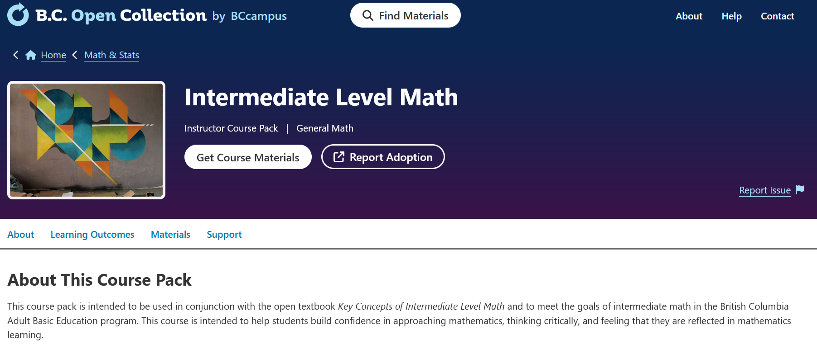
New Open Math Resource
https://collection.bccampus.ca/course-packs/intermediate-level-math/

Slide 4
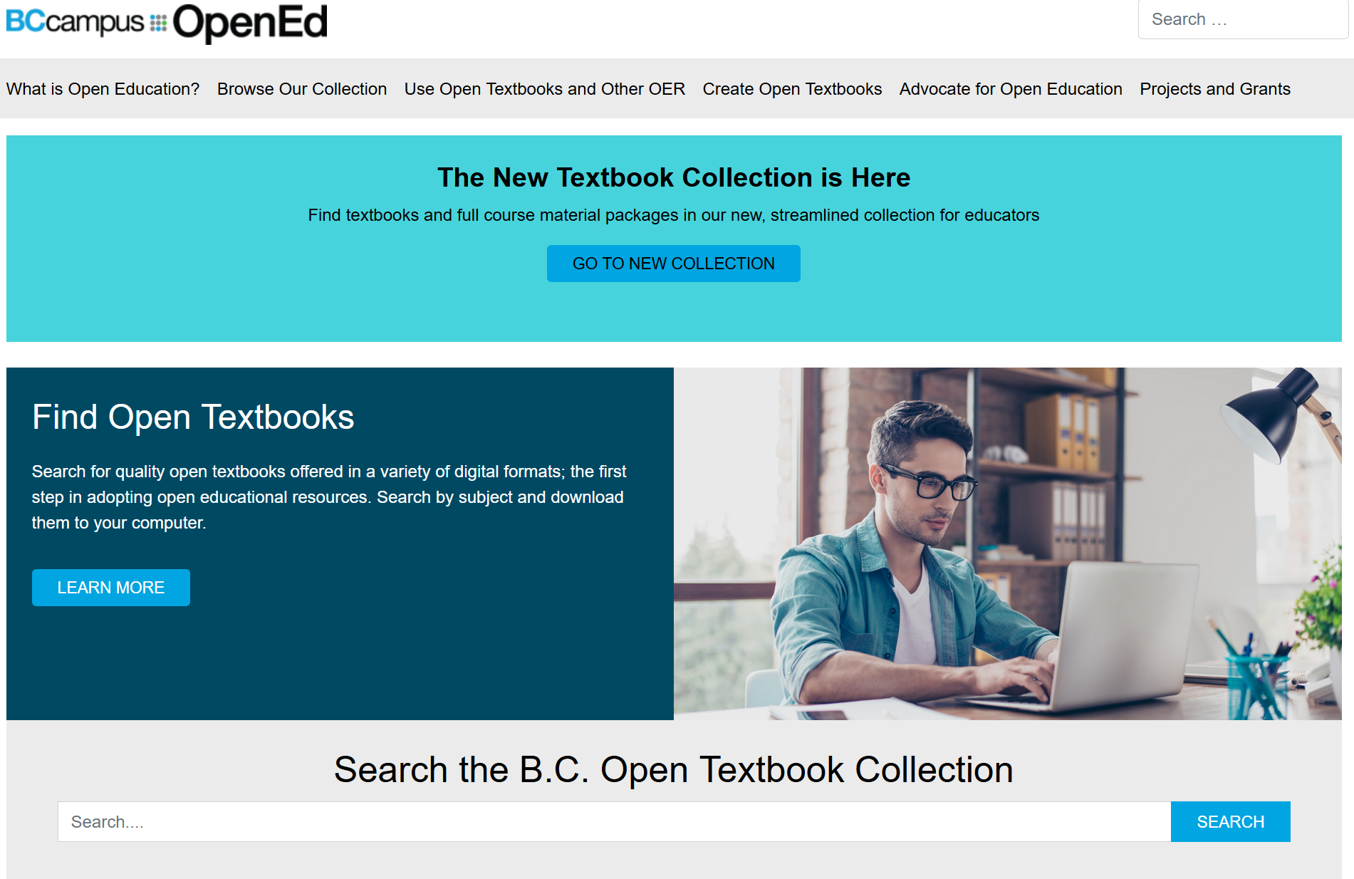
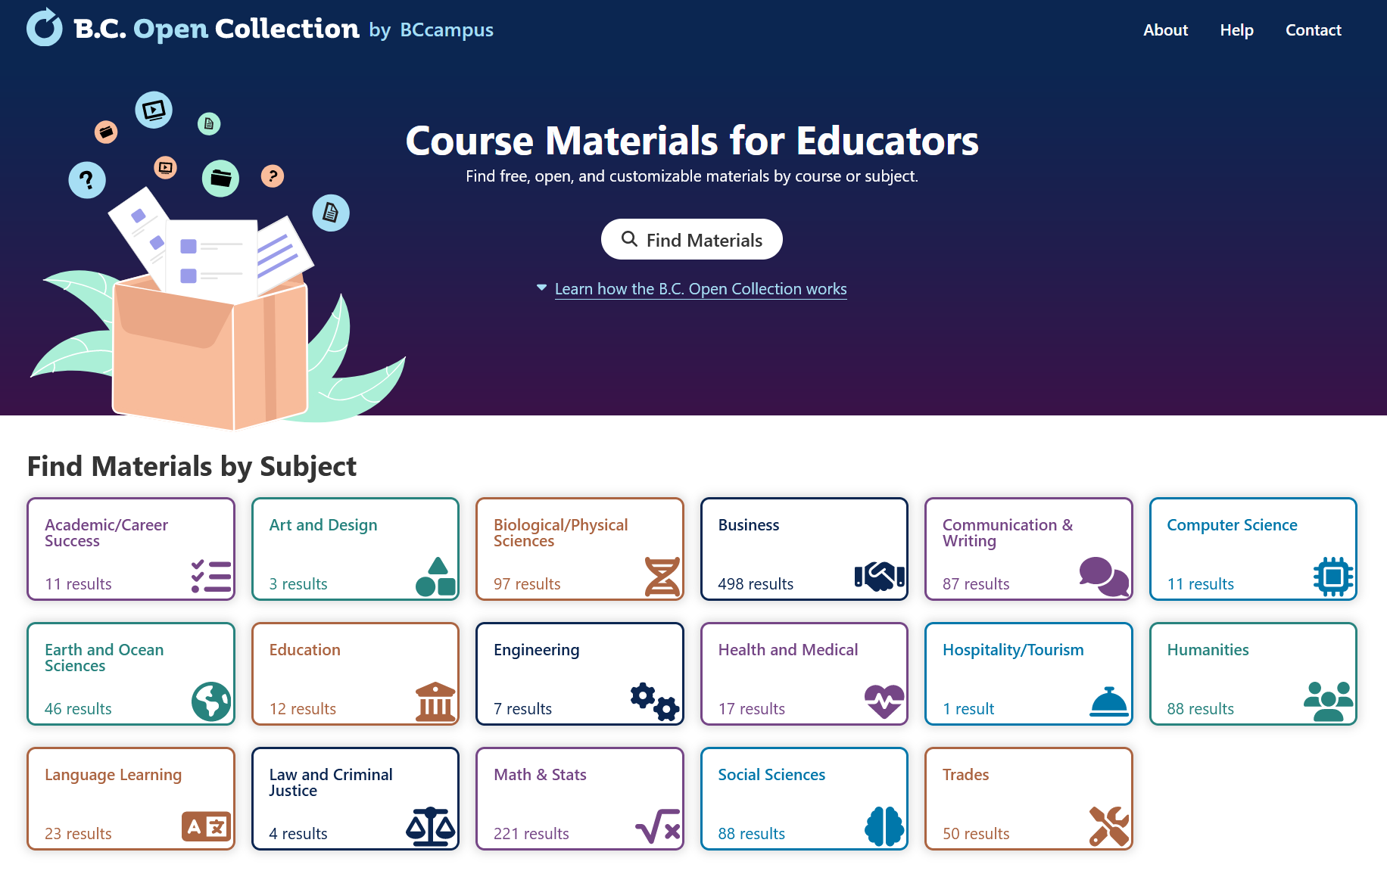
New Open Collection Site
Old site
New site
open.bccampus.ca
collection.bccampus.ca

Slide 5
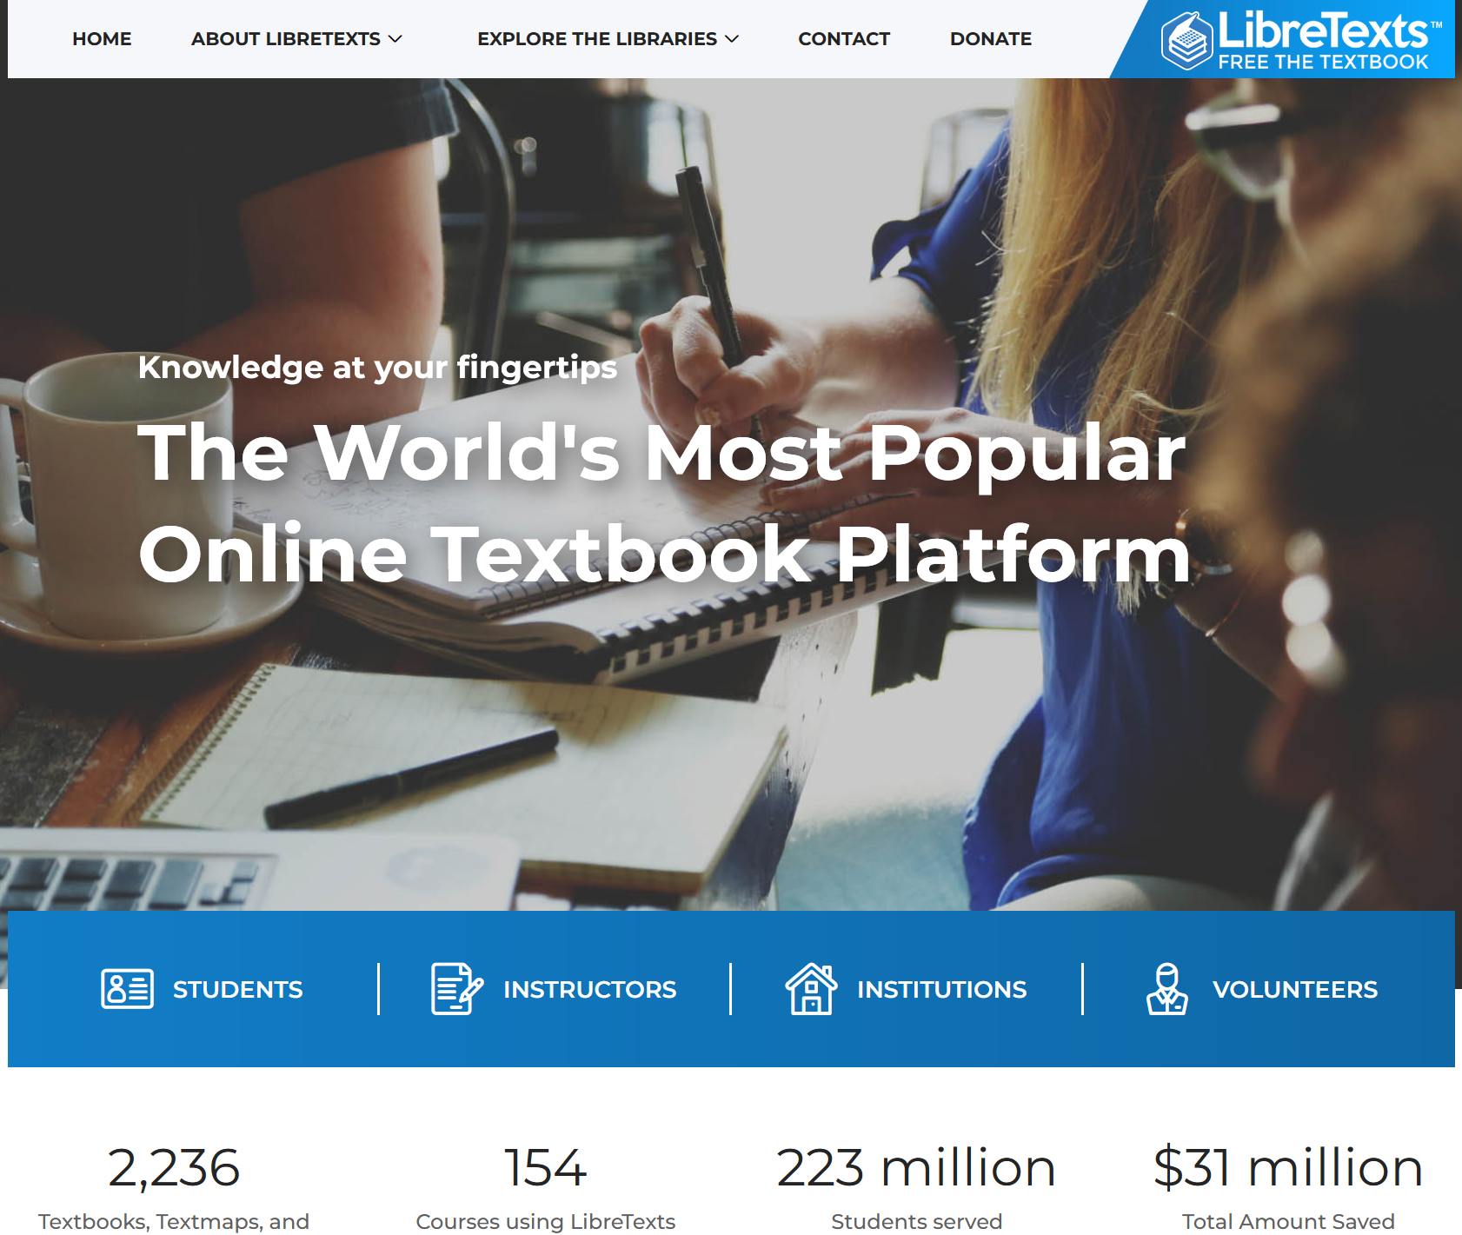
LibreTexts Pilot
Grants to instructors to pilot LibreTexts in their class
CFP – June 2023
Grants awarded – August 2023
Pilot Winter (Jan-April) 2024 term
Details will be released via BCcampus newsletter. Subscribe at BCcampus.ca/subscribe
Libretexts.org

Slide 6
B.C Digital Learning Strategy
“The Digital Learning Strategy outlines strategic priorities, recommended actions, guidance and resources to support the post-secondary system with digital learning in B.C. The strategy was developed by the Digital Learning Advisory Committee, a collaborative effort between the Ministry of Post-Secondary Education and Future Skills and subject-matter experts from across B.C.’s post-secondary system.”
https://www2.gov.bc.ca/gov/content/education-training/post-secondary-education/institution-resources-administration/digital-learning-strategy

Slide 7
Thank you
Clint Lalonde
BCcampus
clalonde@bccampus.ca
May 16, 2023

