Slide 1


Curriculum
Update
BCCAT Articulation Meetings 2019

Slide 2
Curriculum Design - Guiding Principles
Concept-Based, Competency-Driven Curriculum…
Core Competencies are explicit in redesign
Focus on the important concepts and big ideas inherent in the discipline
Emphasize higher order learning and deeper learning
Integrate and embed First Peoples Principles of Learning and Aboriginal knowledge and world views
Reduce the prescriptive nature of curriculum
Allow for flexibility and choice for teachers and student
Enable teachers to be creative and innovative in their design of learning experiences
Align assessment and evaluation with the redesign of the curriculum

Slide 3
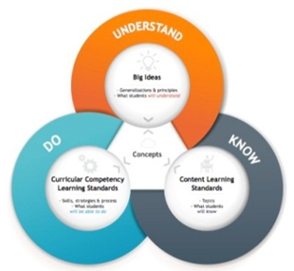
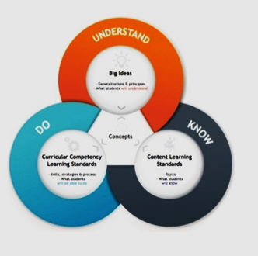
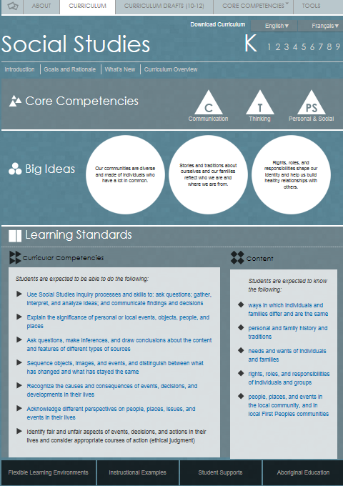
BC’s Know-Do-Understand Model
All areas of learning are based on a “Know-Do-Understand” model to support a concept-based competency-driven approach to learning. Three elements, the Content (Know), Curricular Competencies (Do), and Big Ideas (Understand) all work together to support deeper learning.

Slide 4
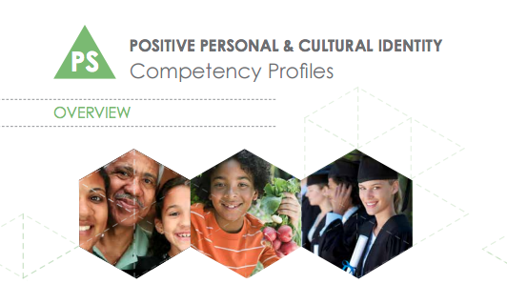
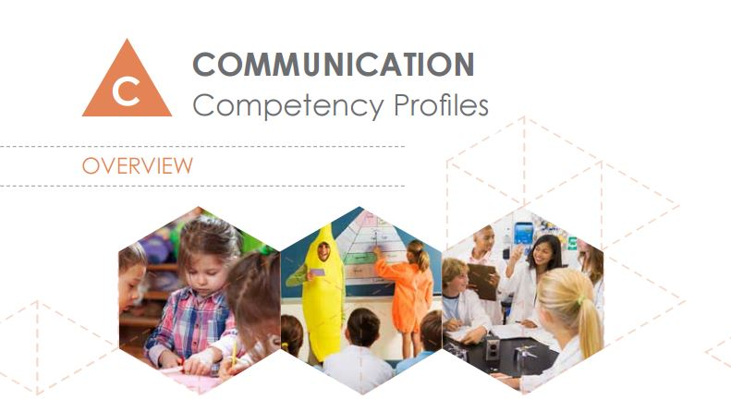

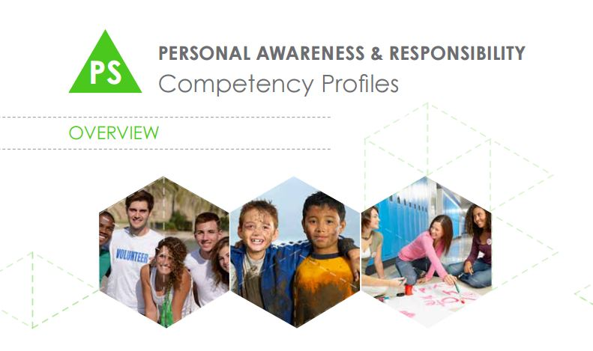
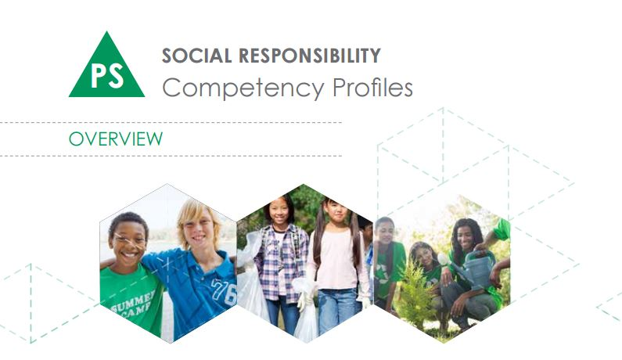
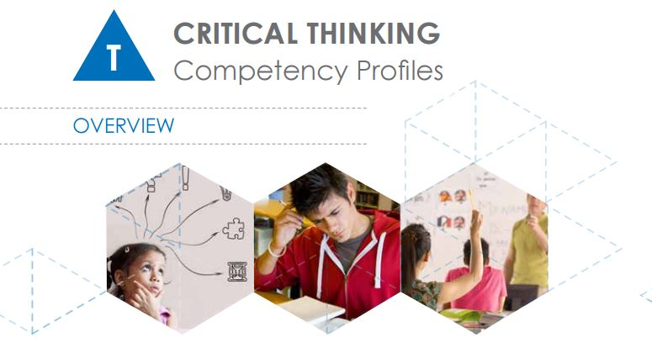
Core Competencies
Core Competencies
Provincial consultation and extensive research identified these categories of core competencies that support life-long learning. Core competencies provide the foundation for the curriculum
Created on a continuum (not by grade level)

Slide 5
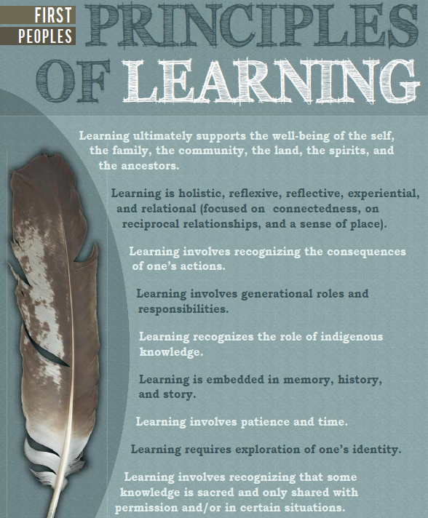

Slide 6
Graduation Requirements
WHAT’S STAYING THE SAME?
WHAT’S CHANGING?
HIGH AND MEASURABLE STANDARDS
Current 80 credits (20 courses) to graduate:
  52 required credits (13 courses)
  28 elective credits (7 courses)
Reporting policy
  Letter grades and percentages
STUDENTS BETTER PREPARED WITH LITERACIES AND COMPETENCIES REQUIRED FOR THE FUTURE
Updated curriculum in all subjects and courses
Mandatory assessments: Numeracy and Literacy
STUDENTS BETTER PREPARED FOR POST-SECONDARY AND CAREERS
8 flexible credits in Career Education
Piloting new Careers strategy

Slide 7
New Curriculum
WHAT’S STAYING THE SAME?
WHAT’S CHANGING?
Provincial curriculum by subject and grade
Course structures for grades
10, 11, 12
Board/Authority Authorized courses to complement provincial curriculum
Close connections with post-secondary to ensure cohesion
Increasing course options to provide greater choice to students
Embedding literacies and competencies the future requires in all curriculum
Indigenous knowledges and perspectives learned across all subjects and grades
Adding new careers courses to the graduation years
Establishing continuous improvement cycle to keep curriculum current

Slide 8
Implementation of the New Curriculum
GRADE 10 CURRICULUM
GRADE 11-12 CURRICULUM
2018/19 school year
2019/20 school year

Slide 9
309 New Grade 10-12 Courses
Applied Design, Skills, and Technologies
Arts Education
Career Education
English Language Arts
Français langue première
French Immersion Language Arts
Languages
Mathematics
Physical and Health Education
Science
Social Studies

Slide 10
English Language Arts/
English First Peoples 10-12
Gr 10 4 credits | Gr 11 4 credits | Gr 12 4 credits
Students choose two from: Composition 10 Creative Writing 10 Literary Studies 10 New Media 10 Spoken Language 10 EFP Literary Studies 10 EFP New Media 10 EFP Spoken Language 10 EFP Writing 10 | Students choose one from: Composition 11 Creative Writing 11 Literary Studies 11 New Media 11 Spoken Language 11 EFP Literary Studies + New Media 11 EFP Literary Studies + Spoken Language 11 EFP Literary Studies + Writing 11 | Students choose either: English Studies 12 or English First Peoples 12 Additionally, students may choose from the following for elective credit: Composition 12 Creative Writing 12 Literary Studies 12 New Media 12 Spoken Language 12

Slide 11
Mathematics 10-12
Gr 10 4 credits | Gr 11 and 12 4 credits
Students choose one: Foundations of Mathematics and Pre-calculus 10 or Workplace Mathematics 10 | Students choose one from: Apprenticeship Mathematics 12 Calculus 12 Computer Science 11 Computer Science 12 Foundation of Mathematics 11 Foundations of Mathematics 12 Geometry 12 History of Mathematics 11 Pre-calculus 11 Pre-calculus 12 Statistics 12 Workplace Mathematics 11

Slide 12
Science 10-12
Gr 10 4 credits | Science 10
Gr 11 and 12 4 credits | Students choose one from: Anatomy and Physiology 12 Chemistry 11 Chemistry 12 Earth Sciences 11 Environmental Science 11 Environmental Science 12 Geology 12 Life Sciences 11 Physics 11 Physics 12 Science for Citizens 11 Specialized Science 12

Slide 13
Social Studies 10-12
Social Studies 10-12
Gr 10 4 credits | Gr 11 and 12 4 credits
Social Studies 10 | Students choose one from: Political Studies 12 Explorations in Social Studies 11 Francophone History and Culture 11 BC First Peoples 12 Contemporary Indigenous Studies 12 Comparative Cultures 12 Comparative World Religions 12 Economic Theory 12 Human Geography 12 Physical Geography 12 Urban Studies 12 20th Century World History 12 Asian Studies 12 Genocide Studies 12 Law Studies 12 Philosophy 12 Social Justice 12

Slide 14

BC Curriculum Comparison Guide
https://curriculum.gov.bc.ca/sites/curriculum.gov.bc.ca/files/pdf/Book_2_BC_Curric_Comparison_Aug_29.pdf

Slide 15
Next Steps
July 2019: Grade 11-12 curriculum mandated for the start of the school year
Curriculum review and revision cycle to be established:
  adhering to our design focus and principles
  collaborative model
  continuous improvement
  online feedback process
  schedule and further website information with be forthcoming

Slide 16

Questions? Comments?

Slide 17
Ministry Contacts
Area of Learning | Coordinator
Applied Design, Skills and Technology | Lisa.1.Marshall@gov.bc.ca
Arts Education | Jennifer.Beyea@gov.bc.ca
Career Education | Lisa.1.Marshall@gov.bc.ca
English Language Arts | TBD
FRAL-Immersion | TBD
FRALP | Suzanne.DionneCoster@gov.bc.ca
Languages | Elmas.Atabay@gov.bc.ca
Math | TBD
Physical and Health Education | Nick.Poeschek@gov.bc.ca
Science | Elmas.Atabay@gov.bc.ca
Social Studies | Nick.Poeschek@gov.bc.ca
Director-Curriculum, Classroom Assessment and Reporting
Angie.Calleberg@gov.bc.ca

