Slide 1
Alberta’s New Learner Pathways System (LPS)tools and proposed ACAT website
May 2017

Slide 2
Topics
  What are the New Alberta Learner Pathways System (LPS) tools and why did we develop them?
  Overview of:
    Learner Pathways Catalog
    Transfer Alberta Website
  New ACAT website under development – what would you like to see?
  Next Steps

Slide 3
Student Pathways Gaps Identified
  Information to help students navigate learner pathways more readily
    Admissions information may not be easily accessible
    Students often do not know that admission requirements must be considered when making transfer decisions
    Transfer and admissions information may be disconnected
  Students wanted access to admissions and transfer information in one well-organized interface designed for mobile and desktop access.
  Question to consider: how can we/should we share more admissions information?

Slide 4
The Alberta Transfer System
  41 post-secondary institutions:
  all 26 Alberta publicly funded PSIs (Campus Alberta)
  5 indigenous institutions (UntnBlue Quills, YTC, Maskwacis, Red Crow, Nechi)
  4 private not-for-profits (Columbia, Prairie, Rocky Mountain Colleges, and Taylor College and Seminary)
  6 OOP PSIs, including our two newest members, URegina and CotRockies. We also have Yukon, Aurora (NWT), and Nunavut Arctic Colleges, as well as TRU - OL (Open Learning).
  Partners at PSIs include senior administrators, instructional faculty, contact people (usually RO staff). We are also reaching out to student advisors.

Slide 5
New Learner Pathways System Principles
1 | Support learner pathways and improve students ability to find relevant information quickly
2 | Partner and collaborate with other provinces / stakeholders in support of interprovincial learner mobility and transfer
3 | Respect autonomy of PSIs and their own systems by allowing more than one point of entry
4 | Provide a system that can compare and share learner pathways and mobility information across institutions and jurisdictions
5 | Simplify administrative processes with effective workflows and make information be available as soon as possible

Slide 6
New Learner Pathways System Principles continued
6 | Create multiple data integration points between AB systems to share relevant information and minimize on administration
7 | Data owners must ensure that their information is up-to-date and honored for student mobility
8 | Design a data warehouse framework that can be extended to accommodate other pathways
9 | Cultivate the culture of best practices and continuous improvements for Learner Pathways with a focus on transfer
10 | Keep the key stakeholders informed of the progress of the initiative throughout the project

Slide 7
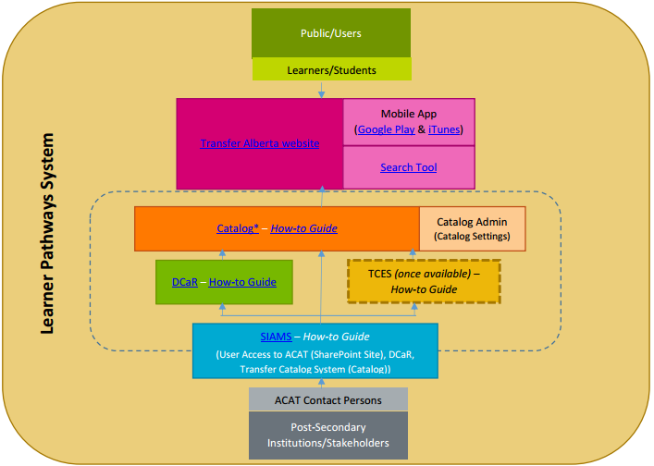
Schematic of the LPS

Slide 8
LPS Data Standards
Data Standards for Courses, Programs, Agreements, targeted High School Transitions data (IB, AP), and Adult Upgrading data
What we collect reflects what is presented in the Search Tool
  Agreement Data Standard – Example
  Ontario and Saskatchewan are interested in some of the tools we are developing.
  A common data standard across jurisdictions would allow data sharing required for transfer agreements, regardless of whether or not LPS tools are used.
InstitutionAgreementID | AgreementType | FromInstitution | FromOffering | ToOffering | CreditValue | Comment | CreditType | Credentials | ReviewDate | EffectiveStartDate | EffectiveEndDate | DeleteRecord
0000152_ACAT_E_F_0061 | Unspecified course | Burman University | ENGL 205 | Option 2xx | 3 |  | Credit | Undergraduate Degree | ######## | 9/1/2016 | ######## | No

Slide 9
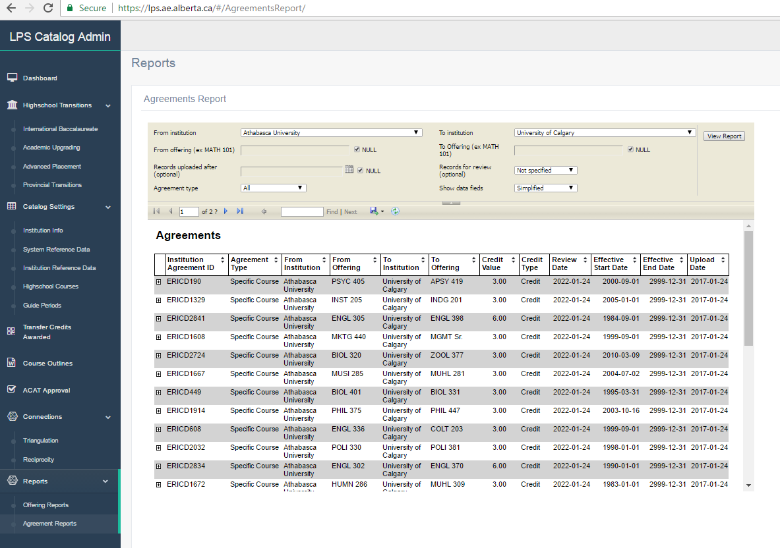
Transfer Credit Evaluation System (TCES) Prototype Screen Shot
  In Development: Similar Look and Feel to LP Catalogue

Slide 10
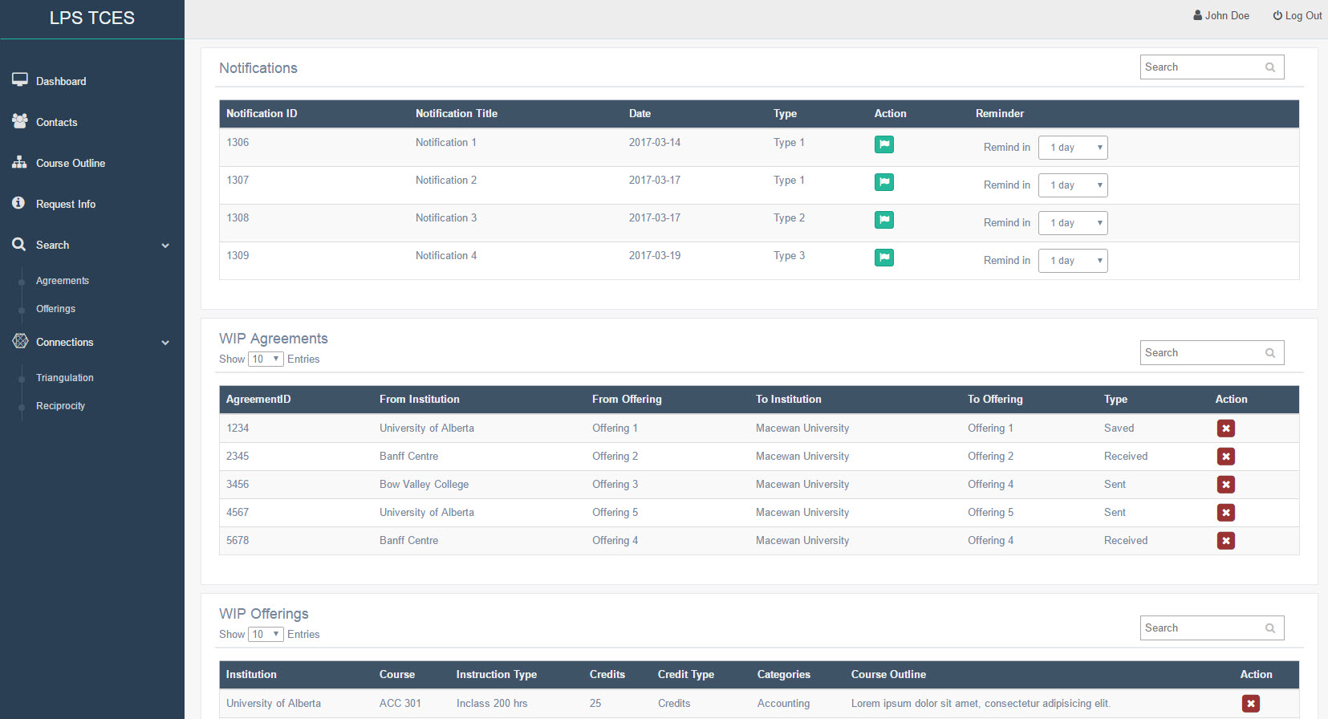
Transfer Credit Evaluation System (TCES) Prototype Screen Shot
  In Development: Similar Look and Feel to LP Catalogue

Slide 11
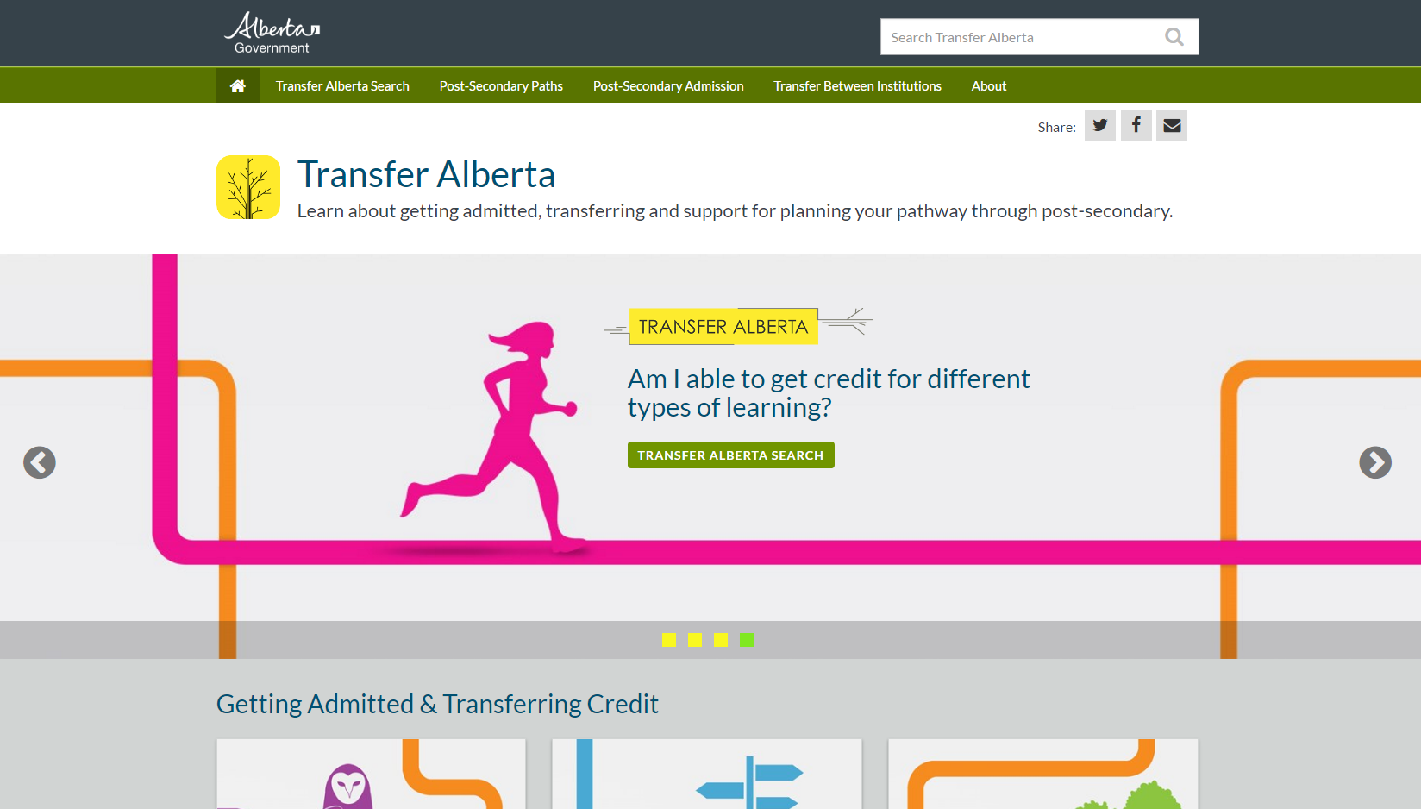
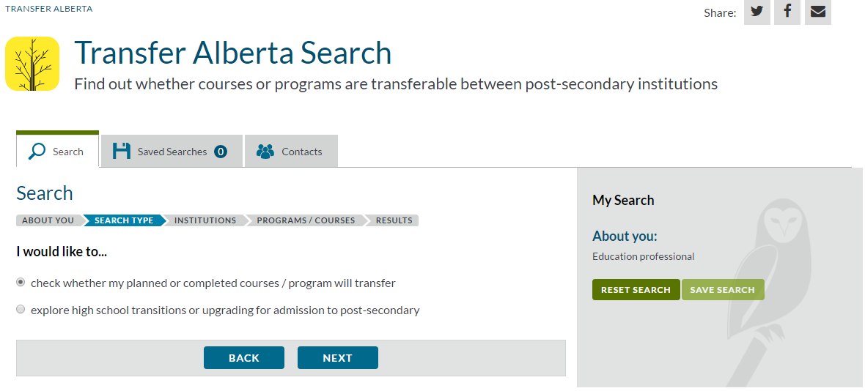
Transfer Alberta Website and Search Tool/Mobile App

Slide 12
What else is on the Transfer Alberta Website?
Planning information for potential students
      Where to study, how to pay for it
High school to post-secondary transition information
    Upgrading, IB and AP, Dual Credit
    Information on specific programs: Engineering, Nursing
Transfer credit information
Types of transfer credit, processes within Alberta, between
provinces, from other countries
Two audiences, two websites:
  Transfer Alberta = students, parents, high school counsellors and post-secondary advisors.

Slide 13
ACAT Website Redesign in Progress
Website Highlights
Homepage – overall design
Proposed Information Architecture reflects audiences:
                ACAT Council information
                Action Plans, Annual Reports
                Articulation Committees
                each committee will have a page
        Contact Persons Information
        LPS training supports
Prominent placement of link to Transfer Alberta site and Search Tool
Interactive Calendar

Slide 14
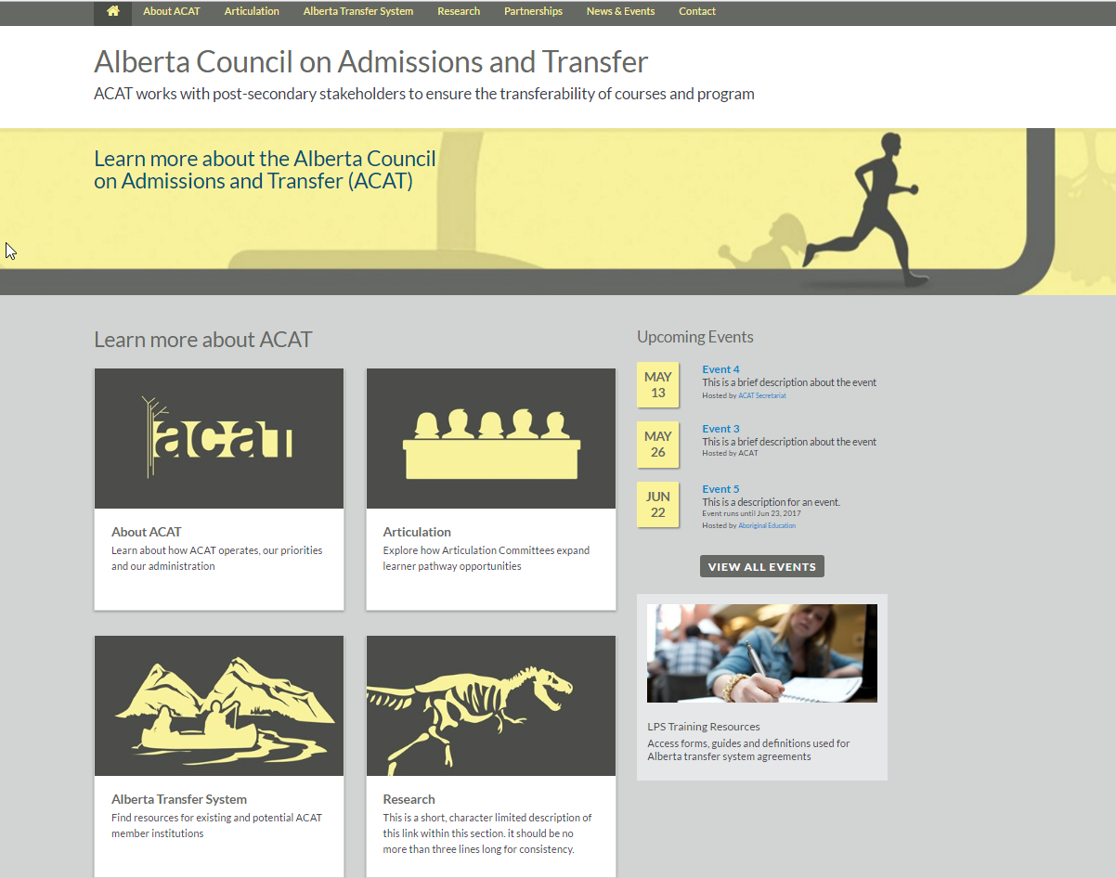
ACAT Website Redesign in Progress

Slide 15
Articulation Committee pages
What would you like to see?
Blurb about committee/discipline
Contacts
Chair/Vice-Chair or
All members?
Terms of Reference
map to plain writing template
Meeting Minutes
(Q: how best to disseminate Agendas?)
Any Publications
(e.g., Biological Sciences Y1 and Y2 chart)
Calendar function
(rolls up from granular to high level)

Slide 16
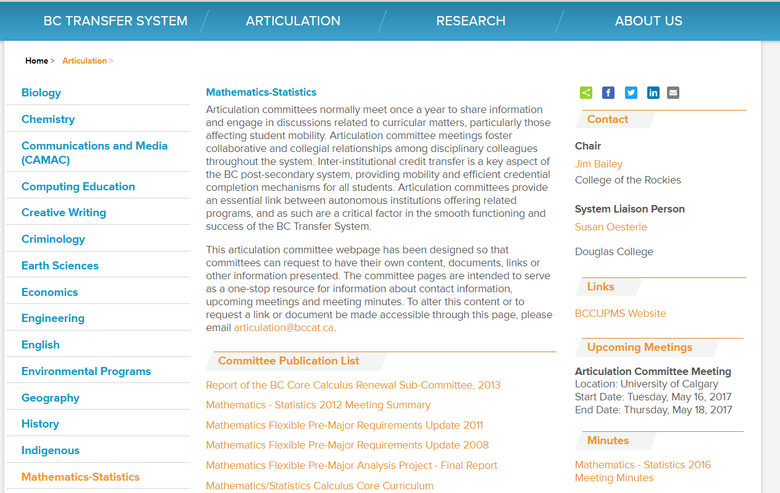
Articulation Committee pages

Slide 17
Articulation Committee Support
Questions:
Not all Committees may have the same answers, but ACAT Secretariat does commonly field these questions:
Can a PSI have multiple representatives on the committee?
What is the procedure for Chair selection?
What types of representatives are a best fit at the table?
May differ by size of institution
E.g., instructional faculty, administrators, advisors, etc.
Fun Fact: We currently have 376 AC members.

Slide 18
Articulation Committee Support, cont.
Workflows:
As part of the new website, all Articulation Committee members will have to enter their information via an online form (data standards!)
The form will have join/replace/withdraw functions.
We will also contact each VPA once a year with their PSI’s committee representatives.
We will have RSVP forms as well, for all meetings.

Slide 19
LPS Tools Next Steps
Completion of the TCES
Late May –TCES in UAT and ready for LPS users/PSIs to test
Stakeholder Tools Planning and Estimated Release Dates (2017-18)
In Progress: Dual Credit and Prior Learning Assessment and Recognition (PLAR) Project Requirements and Charter
April-June –ACAT Website Modernization project underway
May-June – Optimization of Search Tools to increase performance speed
TBA – Business Intelligence and Communication Tools Requirements

Slide 20

Communications toolkit
  Static banners that link directly to the Transfer Alberta website
  30 second information video
  Transfer Alberta poster asset
  Transfer Alberta post card asset
  Special Spotlight Issue/Fact Sheet

Slide 21
Feedback Requested on:
  student facing content on Transfer Alberta website
  articulation workflow issues
  AC questions, AC webpages
  the ACAT website as a whole
  The goal is to create and sustain articulation committees, so that more transfer opportunities can be developed for our students.
  Email; text; vm, etc. clare.ard@gov.ab.ca; 780.690.2772

